Slide 1



WDAH
Under the care of:
Prof. Nancy El-Hefnawy
Dr/ Aida Abouelseoud Nasr | dr.aida_nasr@ics.tanta.edu.eg
Mahmoud Mohamed saleh | mahmoud.saleh.2372001@gmail.com
2-Mohamed Ali Ali Nassar | Nassarmohamed318@gmail.com
3-Sara mohsen Azooz | mohsensara205@gmail.com
4-Ibrhim Mohamed Eita | ebrahimaboeita990@gmail.com
5-Salma Kaled Fouda | Sfouda33@gmail.com

Slide 2
Outline
Objectives
Introduction
Proposed approach
Environment description
Results
Conclusions and future work

Slide 3
Objectives
Medical service robot
Online website diagnosing

Slide 4
There are no free websites to help the patients to diagnose their diseases.
There is no service robot that can interact using the Egyptian dialect to help patients in hospitals.
There are patients in isolation who need care and delivery of treatment, taking into consideration the protection of the medical team and reduction of infection.
Introduction

Slide 5
Proposed approach
Medical service robot
Medical services Website

Slide 6
Cure deliver
Guide
Proposed approach (Medical services robot)
Receptionist
Video conference
Data Entry
Diagnosis of diseases

Slide 7
Proposed approach (Medical service website)
Anemia
Surgical operation
Covid in &out
+
covid-19(96%)
Diabetes probability ,
Diabetes detect
Brain(92%)
Heart problem(98),
kidney

Slide 8
Environment description (Hardware)
Website environment :
Win 10, 64 bit
CPU Core i3, 1.9 GHz
4 Giga Ram
SSD 256 Giga- HHD 100 G
Robot installation environment :
Win 11, 64 bit
CPU Core i7, 2.5 GHz
16 Giga Ram
SSD 256 Giga- HHD 1T
Arduino

Slide 9
Environment description (SW)
Website :
Flask
Python 3.8
TensorFlow 2.7
SQLalchemy
SW Robot installation :
Arduino c
Python
TensorFlow
SQLite

Slide 10
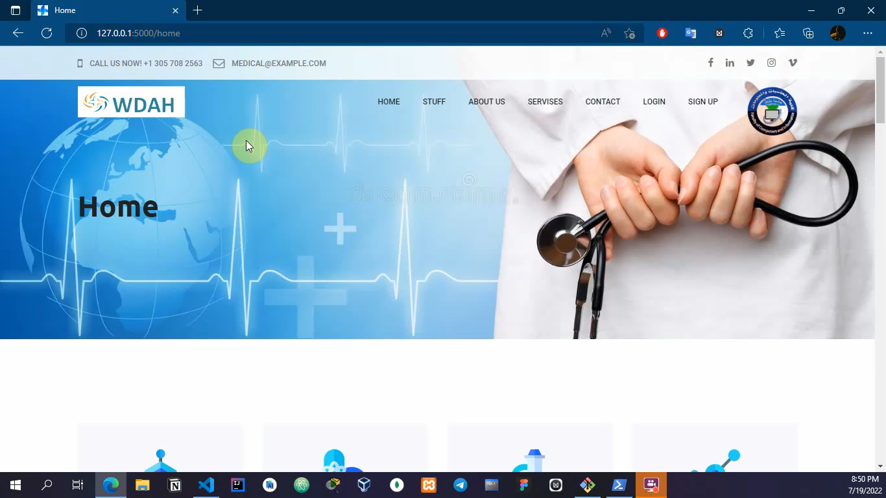
Website Results

Slide 11
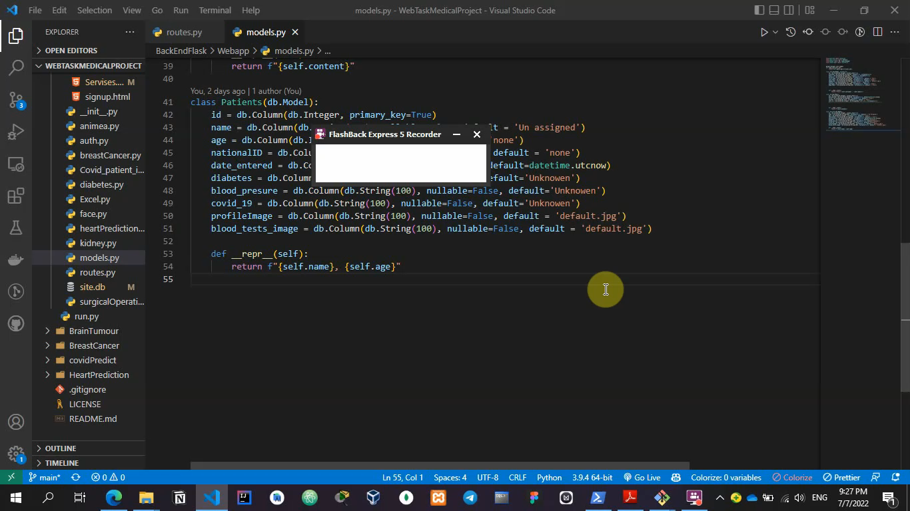
Website Results

Slide 12
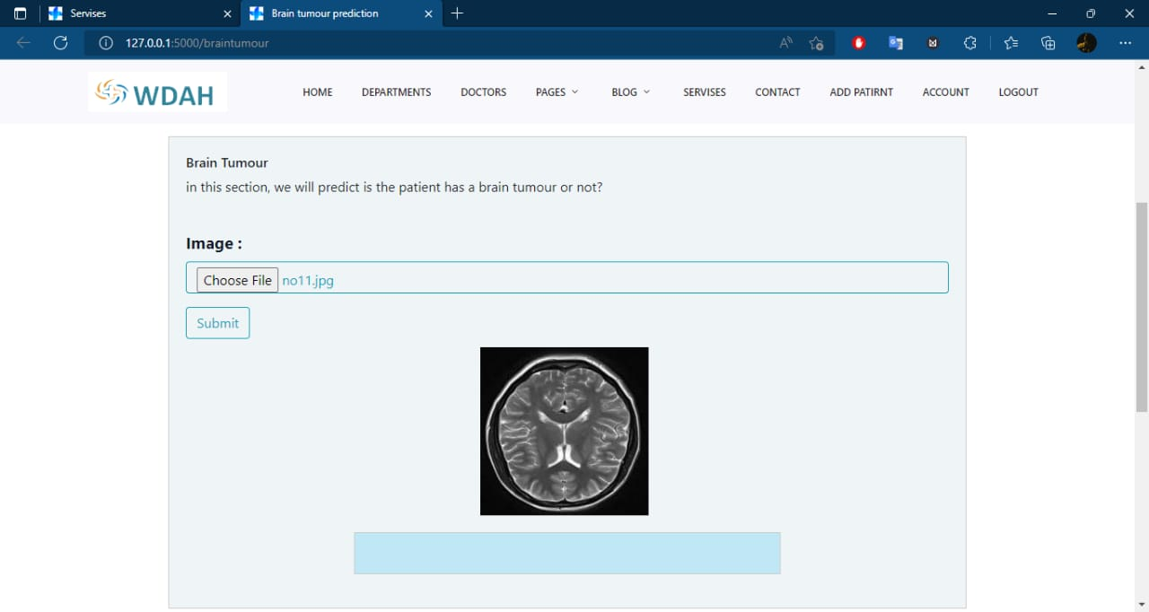
Results

Slide 13
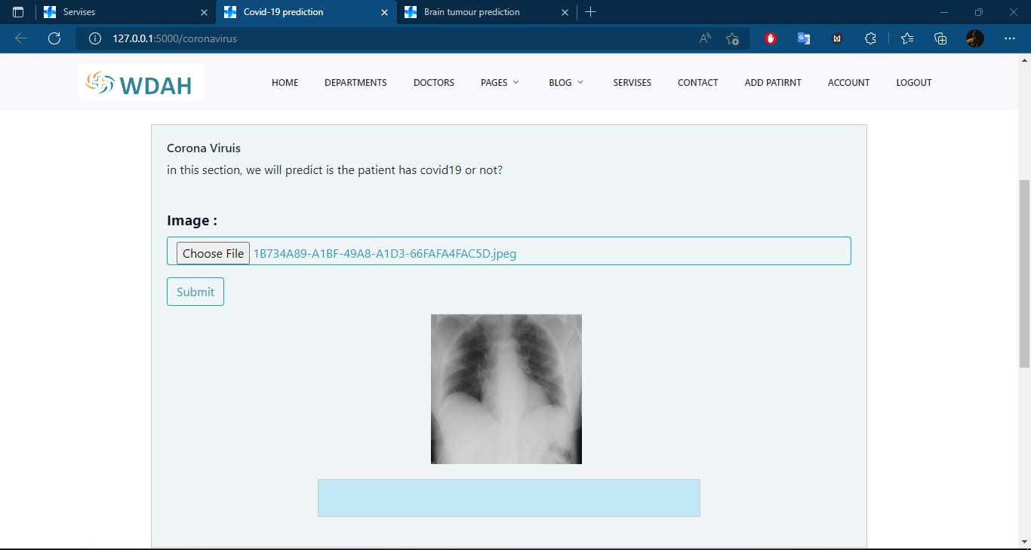
Results

Slide 14
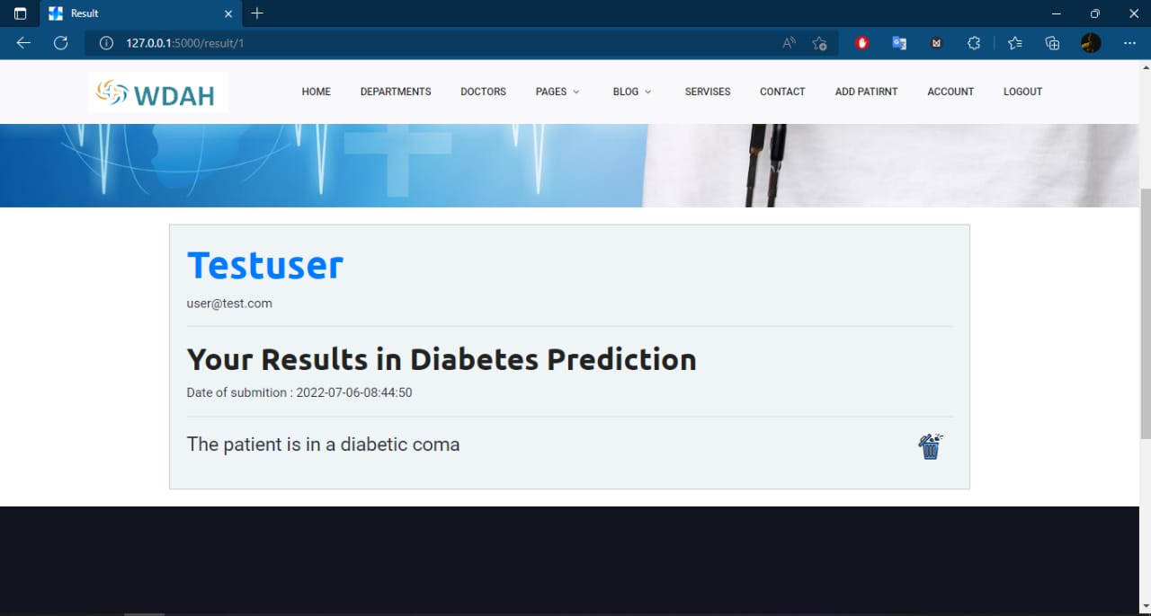
Results

Slide 15
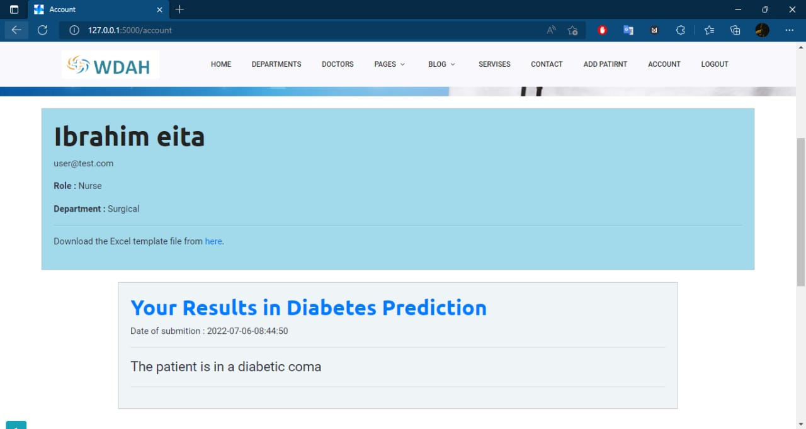
Results

Slide 16
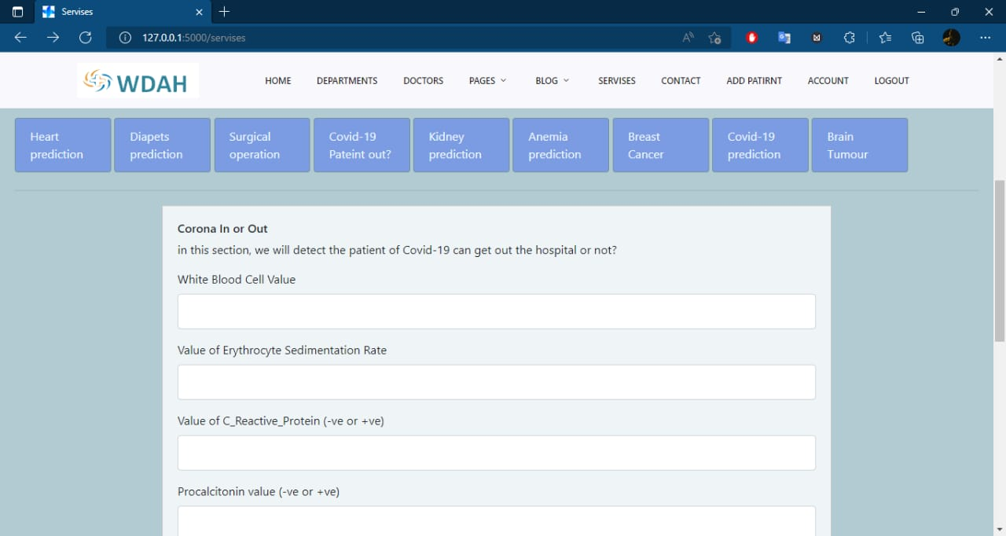
Results

Slide 17
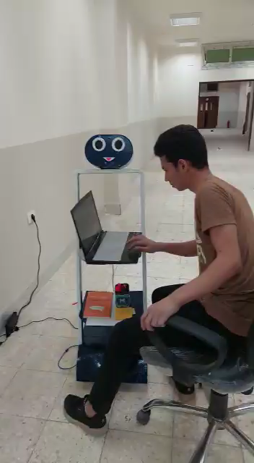
Robot Results

Slide 18
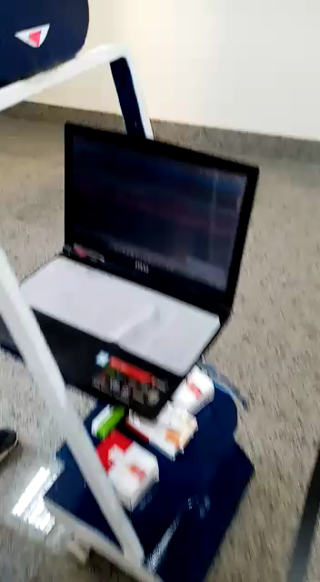
Robot Results

Slide 19

Robot Results

Slide 20
Conclusions
WDAH project consists of a robot and website
The robot can move to deliver cures to patient
The robot can work as a receptionist
Patients can use deceases diagnoses using website for free

Slide 21
Future work
Video conference between doctor and patient
Breast censer
Skin censer
Database Management system

Slide 22


